Slide 1

Project 1 – GitHub Jobs
Team 3 – Who’s Your Data
Brian Abbe, Sam Cooper, Michelle Trujillo

Slide 2
Motivation & Summary
Initial
Hypothesis
Remote positions have become increasingly common as technology has improved and companies are willing to adopt it.
Meant for companies to post jobs.
Data Sources & APIs
Indeed API, Census API, Google Maps API
Requires street address.
No historical data.
Questions
Has the demand for remote positions increased in the last five to ten years?
Where is the greatest demand in the US?
What specific skills in those high demand areas are most commonly listed?
Data is too messy and inconsistent.

Slide 3
Motivation & Summary
Revised
Motivation
Question: What is the relationship between job postings and degrees, remote employment, and job titles.
Null Hypothesis: No correlation between degrees and remote jobs.
Data Sources & APIs
GitHub Jobs API, Google Maps API, Counties CSV, GeoMap CSV
Questions
Do the positions listed on GitHub Jobs show a higher demand for on-site versus remote jobs?
What education level do companies value for the jobs listed on GitHub Jobs?
What types of jobs have the highest demand on GitHub Jobs?
Where is the highest demand in the US for the jobs posted on GitHub Jobs.

Slide 4




Questions & Data
Do the positions listed on GitHub Jobs show a higher demand for on-site versus remote jobs?
What education level do companies value for the jobs listed on GitHub Jobs?
What types of jobs have the highest demand on GitHub Jobs?
Where is the highest demand for the jobs posted on GitHub Jobs?
Data Sources:

Slide 5
Data Cleanup & Exploration
Data Exploration
Initial resources weren’t viable.
Data formatting was inconsistent.
Unexpected Insights
Different ways to get the same result (cleaning vs. contains).
Different types of APIs have different objectives (ex. LinkedIn).
Working with live data.
Limitations
Not enough data to analyze in ways we had anticipated.
Formatting issues (titles, locations, etc.) require manual cleaning.
Assumed that we were working with a static data set, but actually required a lot of cleaning.
STOP

Slide 6
Data Analysis & Findings
Data Fields
GitHub Jobs: Title, Location, Description
Do the positions listed in GitHub Jobs show a higher demand for on-site versus remote jobs?
Methodology
str.contains
Cleaning
Search for “remote” in the title and location columns

Slide 7
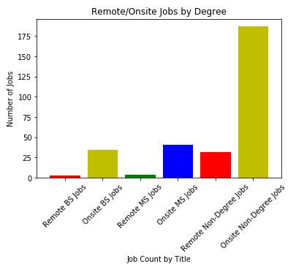
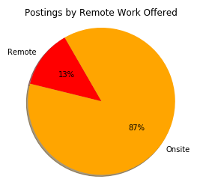
Data Analysis & Findings
Do the positions listed in GitHub Jobs show a higher demand for on-site versus remote jobs?

Slide 8
Data Analysis & Findings
Data Fields
GitHub Jobs – description
What education level do companies value for the jobs listed on GitHub Jobs?
Methodology
str.contains
Assumption that mention is positive
Cleaning
Master, bachelor, bootcamp, none listed

Slide 9
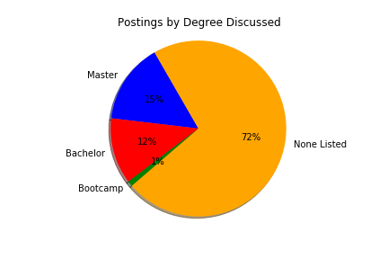
Data Analysis & Findings
What education level do companies value for the jobs listed on GitHub Jobs?

Slide 10
Data Analysis & Findings
Data Fields
GitHub Jobs - title
What types of jobs have the highest demand on GitHub Jobs?
Methodology
str.contains
Cleaning
Identifying key titles and levels.
Consolidating certain titles.

Slide 11
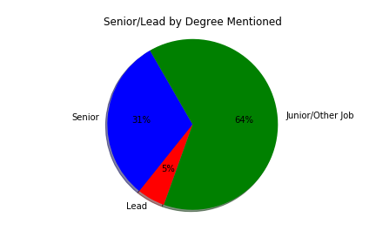
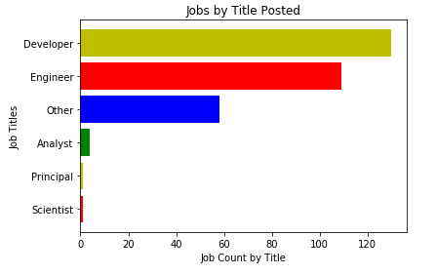
Data Analysis & Findings
What types of jobs have the highest demand on GitHub Jobs?

Slide 12
Data Analysis & Findings
Data Fields
GitHub Jobs – location
Counties CSV – cities, counties, state
GeoMap CSV – zip code, longitude, latitude
Where is the highest demand in the US for jobs posted on GitHub Jobs?
Methodology
Use Google Maps to create a heatmap of data in the US.
Graph countries and states that the most jobs are located in.
Cleaning
Inconsistent location information was given in GitHub. A lot of information was missing. Had to use multiple CSVs to clean up the data.

Slide 13
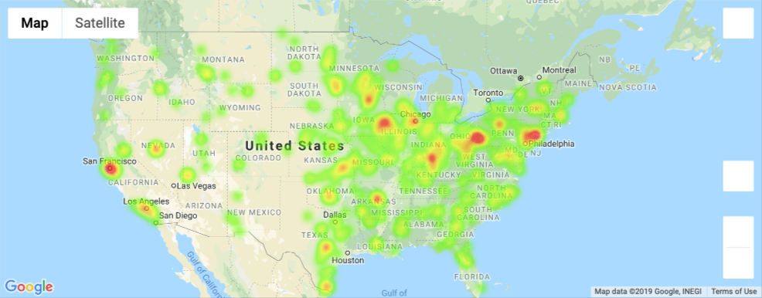
Data Analysis & Findings
Where is the highest demand in the US for jobs posted on GitHub Jobs?

Slide 14
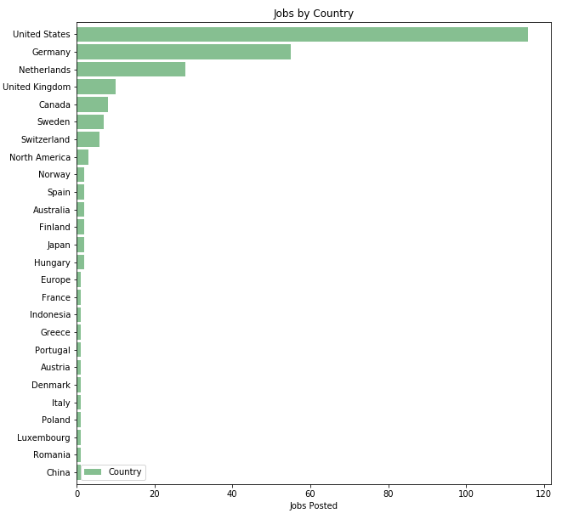
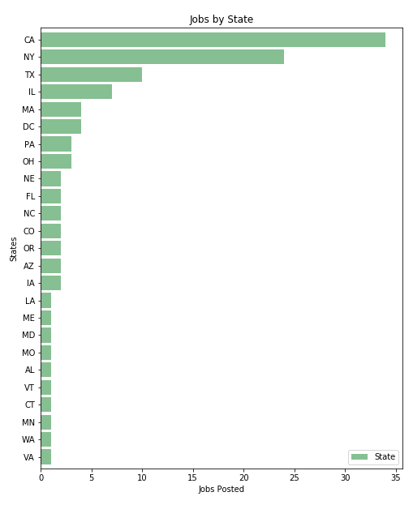
Data Analysis & Findings
Where is the highest demand in the US for jobs posted on GitHub Jobs?

Slide 15


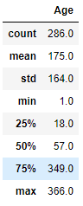
Other Curious Questions
What types of benefits are most commonly offered?
How old are these job postings?

Slide 16
Post Mortem
Question
Question
How do our findings in GitHub Jobs compare to another data set such as LinkedIn or Glass Door?
What key benefits are companies offering in GitHub Jobs?
Question
Cross Reference
What are the benefits offered by company type (i.e. companies with more postings vs. startups)
Cross reference current pieces of our analysis (i.e. what does a heat map of “Developer” positions look like?)
Explore
Explore
Historical data to identify trends in this job market.
More efficient ways to clean location data.

Slide 17
Questions?

